Slide 1
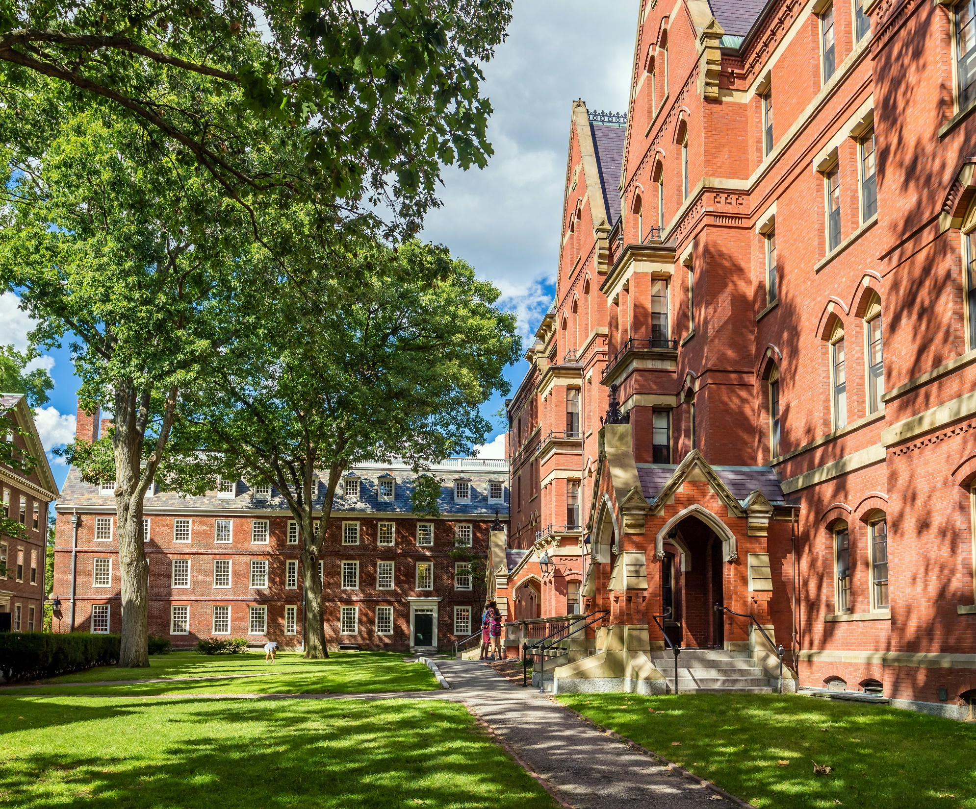
Outside Activities
& Financial Interests in
Sponsored
Programs
Terra DuBois
Gary Wimsett
Chris Hass
Notes:
Time: 1 min
Terra
Introductions

Slide 2
Today’s Agenda
Overview of recent events concerning foreign influence & sponsored research
Discuss NIH and NSF current expectations
Introduce upcoming changes to UF’s disclosure program, including the UFOLIO system
Questions & Discussion

Slide 3
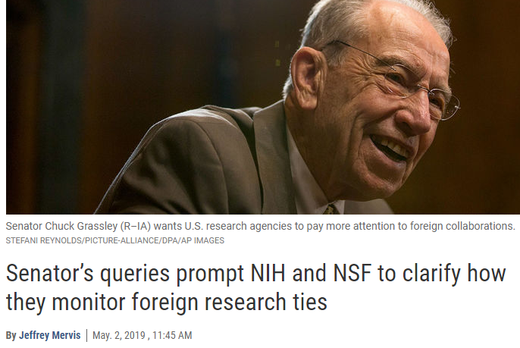
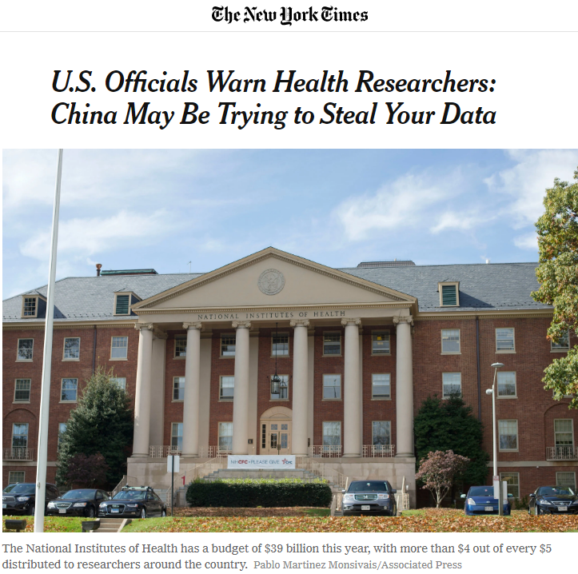
Recent Events

Slide 4
Recent Events
Aug. 20, 2018
NIH Letter to Recipients
Oct. 23, 2018
Senate Letter to NIH
Dec. 21, 2018
NIH Response to Senate
Jan. 3, 2019
Provost & VPR Memo #1
Jan. 31, 2019
DoE Memo re: Talent Programs
Feb. 4, 2019
VPR Memo #2
Mar. 20, 2019
DoD Memo
April 1, 2019
Senate Letter
to DoD
April 15, 2019
Senate Letter
to NSF
April 26, 2019
NSF Response to Senate
May 29, 2019
NSF Issues Draft PAPPG
What’s Next?

Slide 5
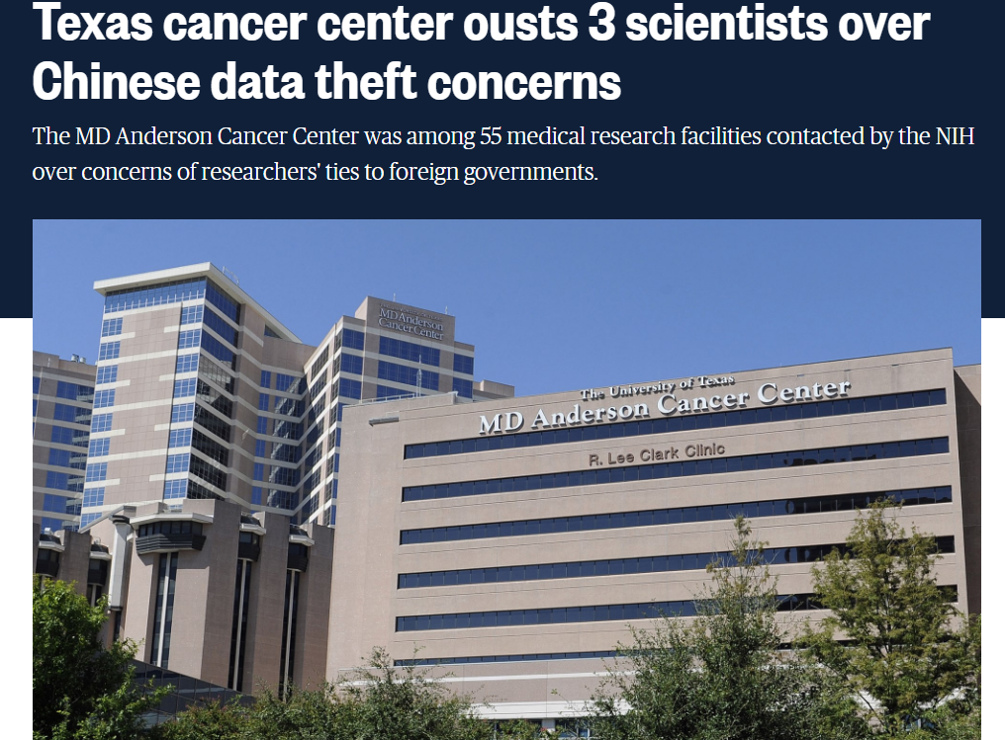
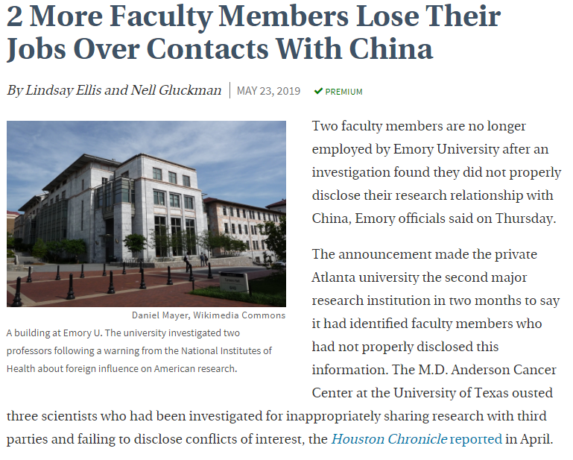
Case Studies

Slide 6
What does this mean for UF research?
Increasing awareness of required disclosures:
  Disclose to sponsors → “other support” and “foreign components” in proposals and annual reports
  Disclose to UF → outside activities and financial interests
Heightened scrutiny of activities with partners in
high risk countries
Certain activities with foreign governments might have negative implications for U.S. grant funding

Slide 7
What to disclose to sponsors
Must disclose all financial support received from a foreign entity
This includes:
  Sponsored funding
  Gifts supporting your UF activities
  Students, postdocs, or visiting scholars working with you at UF who are paid or supported by a foreign entity
  Salary, stipend, honoraria, expense reimbursements, directly paid travel

Slide 8
NIH - Foreign Component
Must report foreign component in new applications and progress reports
Foreign Component:
  The performance of any significant scientific element or segment of a project outside of the U.S., either by the recipient or a researcher employed by a foreign organization, whether or not grant funds are expended.
Examples:
  Involvement of human subjects or animals;
  Extensive foreign travel for data collection, surveying, sampling, etc.;
  Collaborations with investigators at foreign site anticipated to result in co-authorship;
  Using facilities or instruments at foreign site;
  Receiving financial support or resources from foreign entity.

Slide 9
NSF – Current & Pending Support
NSF issued draft language revising the PAPPG to clarify their “other support” requirements within the “Current & Pending Support” section.
This section has been revised to clarify NSF’s longstanding requirements regarding submission of current and pending support information.
NSF does not consider these clarifications to be changes in policy.
New electronic format (or formats) will be implemented to collect current and pending information. Upload of pdf will no longer be permitted.

Slide 10
NSF – Current & Pending Support
Information must be provided for all current and pending support irrespective of whether such support is provided through the proposing organization or directly to the individual.
  Examples include: Federal, State, local, foreign, public or private foundations, non-profits, industrial or other commercial organizations, consulting, or internal funds allocated toward specific projects.
All projects and activities, current or proposed, that require a time commitment from the individual must be reported, even if the support received is only in-kind (such as office/laboratory space, equipment, supplies, employees, students).
  Note: no minimum time commitment established

Slide 11
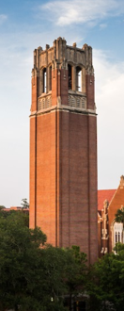


UF Compliance Program
Scope encompasses UF system-wide and is affiliates including UF Health.
Addresses all laws governing higher education and healthcare.
Established as a point of coordination and a resource to all employees for all compliance activities system-wide.
Designed to promote ethical conduct, effectively prevent or detect non-compliance, and maximize compliance with applicable laws and regulations.

Slide 12
UF Compliance Responsibilities
The UF Compliance Program is a collaborative effort from multiple areas including UF Health.
Responsibilities include:
  Providing institution-wide training,
  Advising on compliance related topics,
  Assisting with monitoring efforts,
  Being available as a channel to ask questions and report concerns.
  Keeping the UF Board informed on compliance related matters

Slide 13
Conflicts of Interest
The UF Compliance Program also contains the Conflicts of Interest Program which advises on conflict of interest issues and is developing a new disclosure reporting system collaboratively with key participants.
The UF Online Interests Organizer (UFOLIO) is being introduced in an effort to streamline, modernize, and standardize the way all UF faculty and staff report their activities and financial interests.

Slide 14
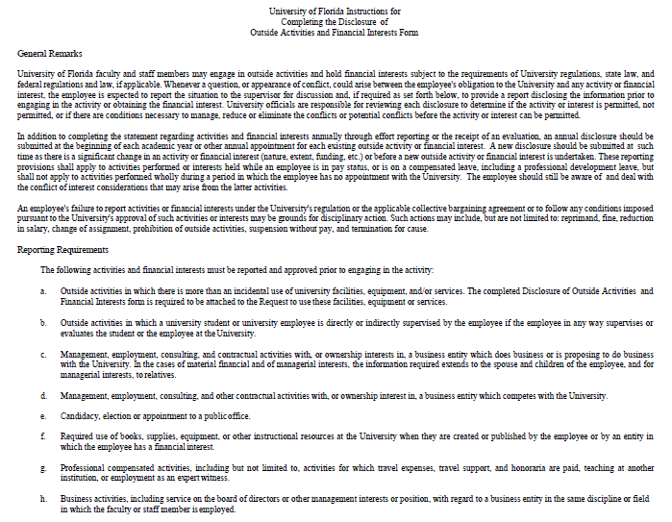
Current Form is NOT
Working

Slide 15
UFOLIO Project Introduction
UF Executive Leadership Team - UFOLIO
Name | Title
Dr. Glover | Provost
Dr. Lane | Senior Vice President and Chief Operating Officer
Dr. Norton | Senior Vice President for Research
Amy Hass | General Counsel
Elias Eldayrie | Vice President and Chief Information Officer
Jodi Gentry | Vice President, Human Resources
Elizabeth Ruszczyk | Vice President and Chief Compliance Officer

Slide 16
UFOLIO Project Introduction
Objectives
Convert the current Outside Interests and Activities Disclosure Form into a new and improved online form that can be used by the University Community by September 1, 2019.
Fully conform to the Florida Code of Ethics and University Regulation 1.011.
Design and build a service that can be improved and extended.
  Phase Two – Integrate UFOLIO with UF Enterprise Reporting
  Phase Three – Deploy the Research Conflict of Interest Module
We need to launch quickly because this is a high priority project for the Board of Trustees, Dr. Glover, Dr. Lane, and Dr. Norton.

Slide 17
UFOLIO Project Introduction
Core Project Team
Name | Role | Email
Gary Wimsett | Project Owner | gwimsett@ufl.edu
Pate Cantrell | Project Manager | cantrell@ufl.edu
Ryan Davison | Faculty and Staff Advocate | rdavison@ufl.edu
Alicia Turner | Administration Advocate | aliciatu@ufl.edu
Angie Brown | Change Management Lead | aabrown@ufl.edu

Slide 18
UFOLIO Project Introduction
Advisory Groups
Name | Provide feedback to help…
UFOLIO Advisory Group | Ensure overall conformance to Florida statutes and University regulation. Make the questionnaire and workflow clear, useful, and appropriate.
Deans’ Advisory Group | Make the questionnaire and workflow clear, useful, and appropriate. Advise project team of challenges specific to your colleges and departments. Communicate between the project team and faculty and staff in your college during the project and service launch.
Faculty and Staff Feedback Group | Ensure the application works as intended.

Slide 19
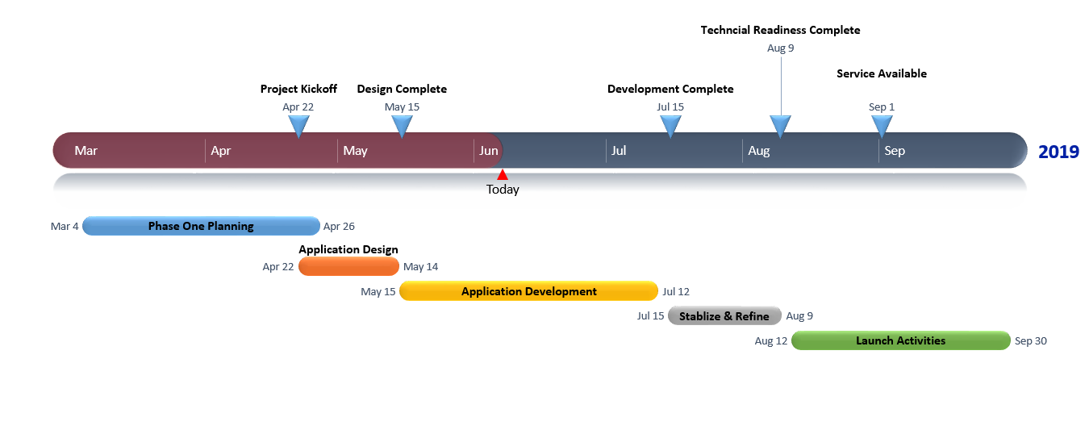
UFOLIO Project Introduction
Project Timeline

Slide 20
Disclose “Outside Activities”
Entrepreneurial or professional services, paid or unpaid, provided by a UF employee to a non-UF entity outside of their UF role, for which any of the following applies:
  The service provided is in the general area of the individual’s expertise per their UF role.
  The time commitment for the activity in any way interferes or conflicts with the individual’s UF responsibility.
  The non-UF entity receiving the services either competes with or does business with UF.

Slide 21
Do Not Disclose – “Inside Activities”
Peer review of articles or research proposals
Unpaid scholarly collaborations at another institution academic or research institution
Editorial services for educational or professional organizations
Services on advisory committees or evaluation panels for government agencies, government laboratories or educational institutions with the U.S.
Conducting workshops for professional societies
Musical or other creative performances and exhibitions that are consistent with the faculty member’s discipline

Slide 22
Important Factors
Use of UF students or employees in activity
Use of UF facilities or infrastructure
Requirements to assign or waive intellectual property
Employment at another university, research institution, or company
Negatively impacts responsibilities to UF

Slide 23
Smart Form
In development. Should reflect senior leadership reevaluation of current disclosure parameters. Narrower focus on activities and interests of significant concern.
Feedback and revision stage (Deans’ Advisory, UFOLIO Advisory, Associate Deans for Research, Faculty Advisory)
Should be designed to eliminate most of the “guess work” involved in disclosure decision (Outside v. Inside).

Slide 24
Stay Tuned!
Certain colleges and departments will be selected for initial rollout in the fall
Training and education for disclosers and reviewers is being developed
Applicable regulations and policies are being evaluated for revision
Bottom Line: we will have an electronic disclosure system the entire university will use

Slide 25
Questions?

Slide 26
Thank You!
Gary Wimsett
Director of Compliance and Conflicts of Interest
UF Compliance
(352) 273-9272
gwimsett@ufl.edu
Terra DuBois
Director of Research Compliance & Global Support
Office of Research
(352) 392-9174
tdubois@ufl.edu
Chris Hass
Associate Provost
Office of the Provost
(352) 392-4792
cjhass@aa.ufl.edu

