Slide 1
RAFT Forum Welcome!

Slide 2
Online Attendees
To ask a question at today’s meeting,
Email Steve Slater at sslater@ufl.edu

Slide 3
Cost Sharing
To ask a question, email sslater@ufl.edu

Slide 4
Definitions
Mandatory: must be included or a proposal will receive no consideration by the sponsor
Voluntary Committed: not required in the solicitation but is quantified or referenced in the budget or justification
Includes university faculty effort that is over and above that which is committed and budgeted for but not charged to the sponsored agreement – i.e. the minimum faculty time required to complete the work if not quantified. (See M-01-06 on next slide)
Voluntary Uncommitted (VUCS): not initially promised in the proposal or otherwise indicated. For example, if an investigator proposes and charges 25% effort, but the investigator actually devotes 35% effort, the additional 10% effort that was not originally promised is VUCS. VUCS may not be charged to another sponsored project.
Over the cap: not technically “cost sharing” in the federal world as it is not allowable cost. However, it is a cost borne by the University not paid by the sponsor.

Slide 5
OMB Memorandum M-01-06
… programs should have some level of committed faculty (or senior researchers) effort, paid or unpaid by the Federal Government. This effort can be provided at any time within the fiscal year (summer months, academic year, or both). Such committed faculty effort shall not be excluded from the organized research base by declaring it to be voluntary uncommitted cost sharing. If a sponsored agreement shows no faculty (or senior researchers) effort, paid or unpaid by the Federal Government, an estimated amount must be computed by the university and included in the organized research base. However, some types of research programs, such as programs for equipment and instrumentation, doctoral dissertations, and student augmentation, do not require committed faculty effort, paid or unpaid by the Federal Government, and consequently would not be subject to such an adjustment.
Source: https://www.whitehouse.gov/omb/memoranda_m01-06

Slide 6
Best Practices
Don’t do it
If you have to do it, minimize it
If you minimize it, choose salary or unrecovered F&A over non-salary expenses
If faculty wish to include reference to resources provided by the institution, DO NOT quantify and include in the FACILITIES & RESOURCES sections. The value of the resources can be easily demonstrated without quantifying (i.e. we will provide two training slots or provide computing resources)
No cost extensions – include in the justification any reductions in effort for key personnel during the extension period

Slide 7
Tools for Tracking and Documenting Cost Share
To ask a question, email sslater@ufl.edu

Slide 8
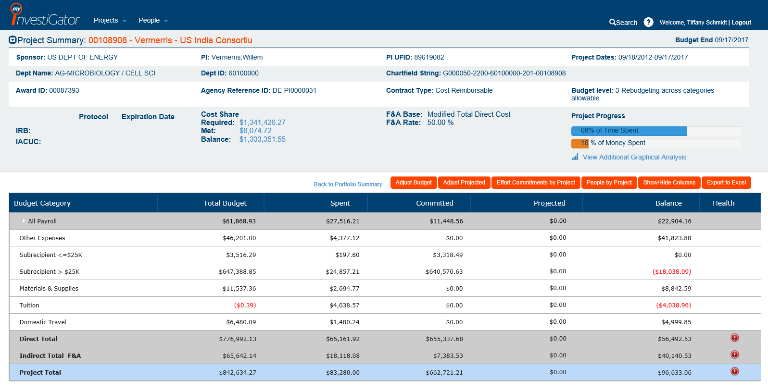

Slide 9
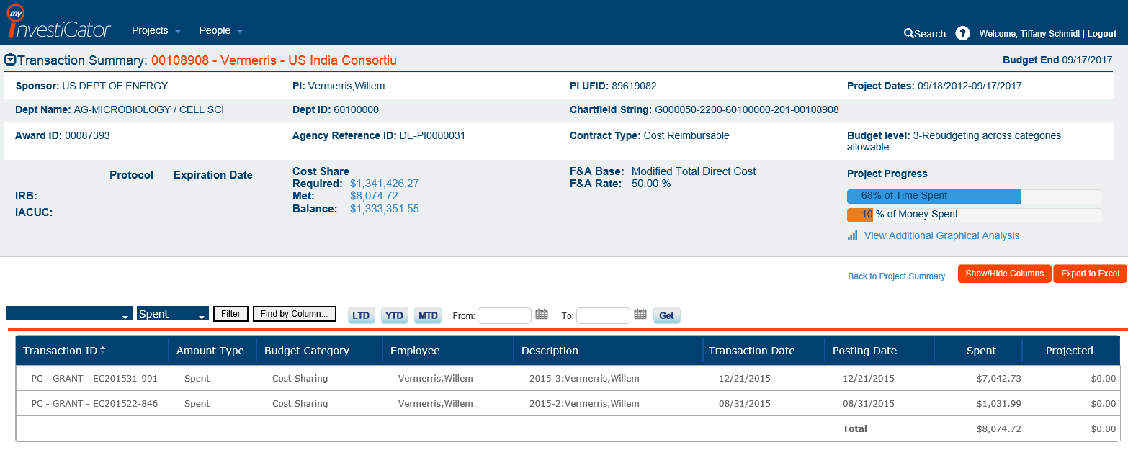

Slide 10
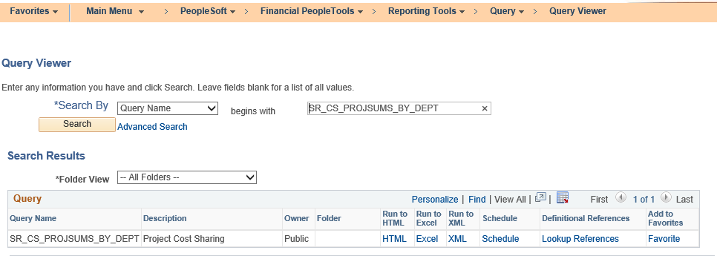
Cost Share Report by Department

Slide 11
Cost Sharing Effort (Salary)
Communicate cost share commitment for entry into the commitment module
Certify effort timely
Effort cost share uploads occur once per semester
Effort not certified prior to this upload must be entered manually via a request to C&G.

Slide 12
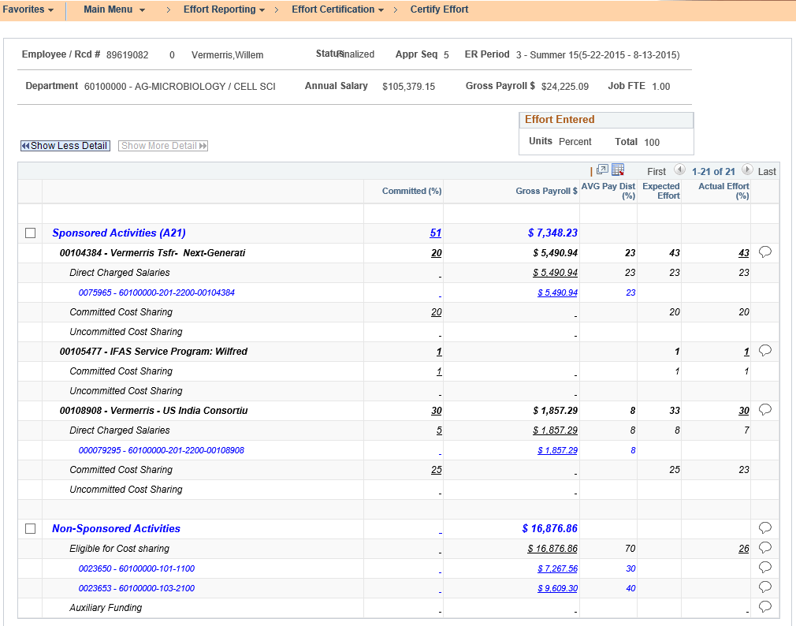

Slide 13
Non-Salary Cost Share
Must be submitted to C&G via a request of manual cost share entry
Manual cost share entry requests must be accompanied by support
The manual cost share request form can be found on C&G’s website http://www.cg.cfo.ufl.edu/wp-content/uploads/2013/11/Request_for_CS_Manual_Entry_Form.pdf

Slide 14
Third Party Cost Share
Outlines services, supplies or equipment
Identifies value
Signed by an officer of the company
Support must be submitted to C&G for entry into myUFL
Check with your third party often

Slide 15
Internal Programs
For Opp fund and CTSI programs:
According to Dr. Nelson for CTSI & Dr. Norton for Opportunity Fund
Commitments are required and will be tracked
If you indicate faculty committed time is required to complete the project, those providing University funds expect your time to be protected to execute on those commitments. Else – funding will be allocated elsewhere where project goals are more likely to be achieved.

Slide 16
Resources
Handbook policy: http://research.ufl.edu/research/handbook/policies/cost-sharing.html
OMB memorandum M-01-06: https://www.whitehouse.gov/omb/memoranda_m01-06
Effort Reporting Directives: http://generalcounsel.ufl.edu/media/generalcounselufledu/documents/EffortReportingDirectivesProcedures.pdf specifically 2.1
2.1 required commitments
3.4 rebudgeting vs change in commitments

Slide 17
March 29th, 3:00 – 4:30 p.m. Topic: Reporting April 19th, 3:00 – 4:30 p.m. Topic: IRB & IACUC Feedback
Upcoming Forums

