Slide 1
RAFT Forum Welcome!

Slide 2
Online Attendees
To ask a question at today’s meeting,
Email Steve Slater at sslater@ufl.edu

Slide 3
Export Control Compliance
for Research Administrators
Terra DuBois
Assistant Director of Research Compliance
352-392-9174 - compliance@research.ufl.edu

Slide 4
What We’ll Cover Today
Export Controls Defined
Export Compliance at UF
Red Flags
International Travel and Visitors
Case Study and Discussion

Slide 5
What are Export Controls?
Laws that control and restrict the release of equipment, chemical and biological materials, information, technical data, software, source code, and services to foreign persons or countries.
Purpose of restrictions is to protect U.S. national security and promote U.S. foreign policy, anti-terrorism, and non-proliferation interests.

Slide 6
Applicable Regulations
International Traffic in Arms Regulations (ITAR)
Administered by the Department of State
Control technologies with military and space applications
Export Administration Regulations (EAR)
Administered by the Department of Commerce
Control civil and dual-use (both military and civilian applications) technologies
OFAC Regulations
Administered by the Office of Foreign Assets Control (Department of Treasury)
Control fiscal and trade transactions, travel, and other activities with sanctioned countries

Slide 7
Prohibited Activities
Export of controlled goods, technology, or software/source code without a license or other authorization to prohibited destinations, end-users, or end-uses
Certain activities with, or some travel to, U.S. sanctioned countries
Cuba | Iran
North Korea | Sudan
Syria | *And others with fewer sanctions

Slide 8
What’s an Export?
The transfer of controlled goods, technology, software/source code, or assistance to a foreign person either outside or inside the United States
Exports can occur through:
Shipping items to other countries
Visual inspection of ITAR-controlled equipment or data
Emails
Phone calls or in-person conversations
Presenting controlled information at conferences
Hand-carrying controlled items during international travel

Slide 9
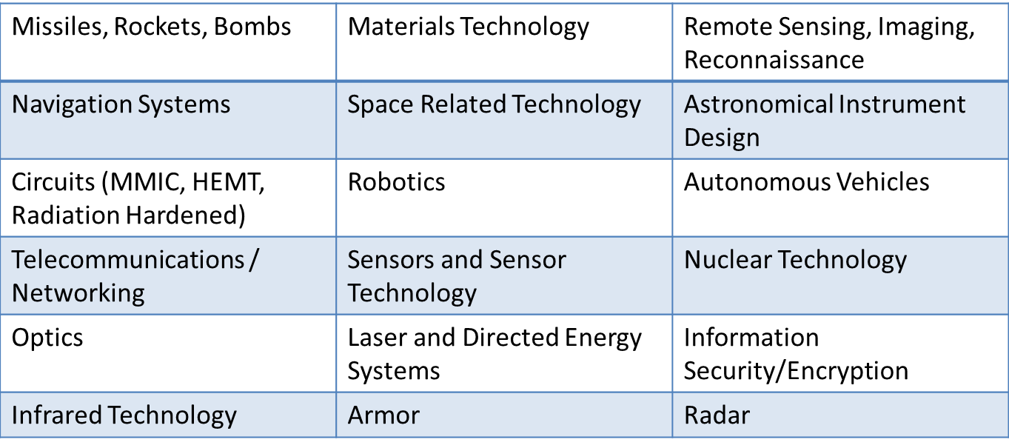
What’s Controlled?
Items and information specifically listed on the United States Munitions List (USML) or the Commerce Control List (CCL)
In general, items, information, and software related to the following areas may be controlled: (*Not All-Inclusive List*)

Slide 10
Fundamental Research Exclusion (FRE)
Basic and applied research, AND
At an accredited institution of higher learning in the U.S., AND
Research results are ordinarily published and shared broadly within the scientific community
As long as these conditions are met, the results of the research are not subject to the ITAR or EAR even if the research’s subject area appears on the USML or CCL

Slide 11
FRE Is Lost If:
UF or the researcher accepts any restrictions on publication of information resulting from the research; or
UF or the researcher accepts a prohibition on foreign nationals participating in the research

Slide 12
EC Process for Research Projects

Slide 13
Red Flags
EC Warning in Solicitation | SBIR/STTR Funding
DoD, DoE, NASA Funding | Military or Space Research
Foreign Travel, Collaboration, or Sponsor | Publication Restrictions
Foreign National Restrictions | Distribution Statements other than “A”
Associated Agreements – NDA, MTA, MOU | Physical Exports

Slide 14
Travel & Conferences
In general, travel to most countries and bringing typical/usual items with you will not require a license (e.g., standard laptop, cell phone, personal items)
DRC Travel Website - http://research.ufl.edu/faculty-and-staff/research-compliance/export-controls/international-travel.html
Caution: Comprehensively Embargoed Countries (Cuba, Iran, North Korea, Sudan, Syria)
Caution: Hand-Carry or Shipping Special Equipment (e.g., infrared camera)
Caution: Do not present or discuss any controlled information, even at domestic conferences

Slide 15
International Visitors
Two main concerns: (1) access to ITAR or EAR information and (2) working with denied parties
Foreign partners in U.S. on valid Visa may participate in any work within the scope of the Visa
But, still cannot access certain controlled equipment and information without a license or exemption

Slide 16
International Visitors
The U.S. government has identified certain persons and entities with whom exports and collaborations are either prohibited or require special approval → Denied Parties
Before you host an international visitor in your lab or begin an international collaboration, request restricted party screening from Division of Research Compliance

Slide 17
Case Studies and Discussion

Slide 18
Case Study – Pre-Award
Professor Gator from Computer Engineering asks for your help in applying for a subcontract from War Radar Corp. (WRC) to work on improved radar techniques for military surveillance and detection systems. The prime sponsor is the U.S. Army.
In reviewing the STTR solicitation, you find the following language:
The technology within this topic is restricted under the International Traffic in Arms Regulation (ITAR), which controls the export and import of defense-related material and services. Offerors must disclose any proposed use of foreign nationals, their country of origin, and what tasks each would accomplish in the statement of work in accordance with section 5.4.c.(8) of the solicitation.

Slide 19
Case Study – Pre-Award
What else should you look for in the proposal?
Foreign nationals participating
International travel
Equipment purchases or shipments
What should you tell the PI?
Budget for additional IT security needs
Consult with Research Compliance

Slide 20
Case Study – Contracting
Great news: Prof. Gator got the WRC contract! You’re negotiating the contract with WRC, and you find the following terms:
DFARS 252.204-7000 (Oct. 2016) – Disclosure of Information
UF cannot release any project information unless “the information results from or arises during the performance of a project that involves no covered defense information…and determined in writing by the contracting officer to be fundamental research….”
Distribution Statement D – Distribution Authorized to the DoD and DoD Contractors Only
“No foreign nationals may participate in this project without prior approval from the assigned U.S. Army contracting officer.”

Slide 21
Case Study – Contracting
What red flags should you raise?
Military-related subject matter
DoD prime sponsor
Publication restrictions (7000 clause & Distribution Statement D)
Foreign national restriction
There are a bunch of red flags! What now?
Send it to Research Compliance for review

Slide 22
Case Study – EC Analysis
DRC reviewed the SOW and determined that the project is likely controlled by Category XI of the ITAR. But, Prof. Gator says that his work can’t be export controlled because “I’m only testing various algorithms that could have both military and non-military applications. This is an educational institution, for goodness’ sake! It’s basic science!”
Can we rely on the fundamental research exclusion in this case?
No, the publication and foreign national restrictions prevent us from classifying Prof. Gator’s work as “fundamental research.”

Slide 23
Case Study – Lab Staff
DRC worked with Prof. Gator to set up a TCP and put the proper IT security measures in place. The project is entering the second phase, but Prof. Gator is too busy to finish it on his own. He asks you to help him hire a fabulous new post-doc that he met at a conference in France. The post-doc is a French national.
What are the red flags? What would you do?
Contractual restriction; project is controlled
Remind PI of restrictions; refer to DRC
DRC/DSP determine if sponsor will allow FN participation with license from Dept. of State. If so, DRC will apply for license.

Slide 24
Case Study – Visitors
Prof. Gator has been publishing like crazy and he’s gaining a lot of international exposure. A junior professor from Oxford University in England wants to spend six months working in Prof. Gator’s lab. Prof. Gator assures you that the Oxford professor will not work on any export controlled projects or have access to controlled data.
What are the red flags? What would you do?
Embargoed country?
Refer to DRC for restricted party screening

Slide 25
Case Study – Travel
Prof. Gator recently published a paper on wireless communication technologies for developing areas. Prof. Caiman from the University of Havana in Cuba is very interested in Prof. Gator’s paper and asked him to present the paper at an upcoming conference in Havana. Prof. Gator asked you to help him set up the travel and to find out if he can bring his laptop.
What are the red flags? What would you do?
Cuba travel ok for professional research or meetings
Warn Prof. Gator to only discuss public information & make sure his laptop doesn’t have any controlled data on it; refer to DRC, if needed
Advise Prof. Gator to register travel with UFIC and complete special Cuba certification
Advise Prof. Gator to review DRC travel website: http://research.ufl.edu/faculty-and-staff/research-compliance/export-controls/international-travel/activies-with-cuba.html

Slide 26
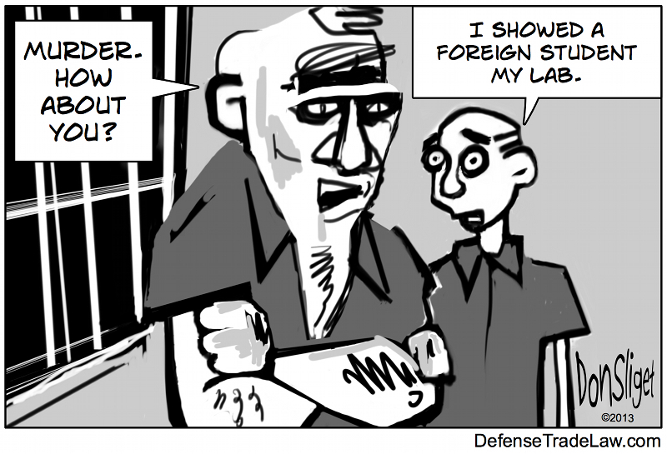
Questions?

Slide 27
Thank you!

